Slide 1

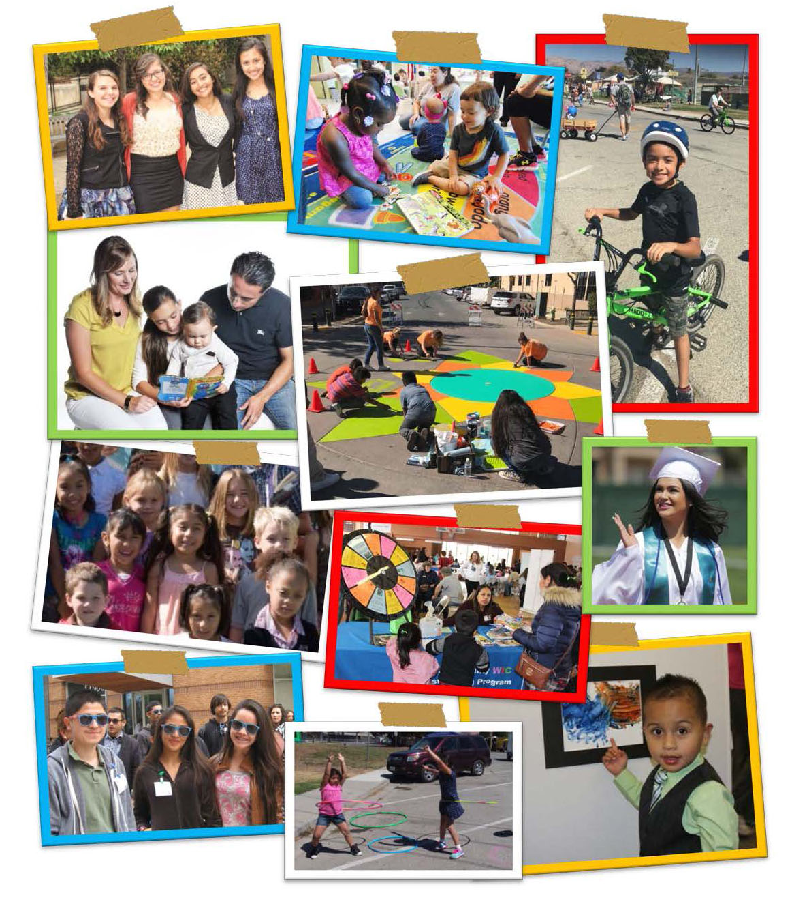
2017-2018 Annual Report Presentation
May 14, 2019
Notes:
Introduction: Self. Annual Report for the early childhood development initiative Bright Beginnings – [type = “collaborative” ]
Es un movimiento bilingue, entonces esta presentacion seria en dos idiomas – gracias a los interpretes
[we try to apply our advice to ourselves – it is best for children to be supported in learning in their home language ☺]
Purpose:
Bridge the gaps between the organizations who are doing work on behalf of the residents of our County and the Board of Supervisors (BoS) who are responsible for making the policy decisions
opportunity to advise and inform the BoS,
chance for the BoS to provide direction to the organizations.
2) Increase the transparency and accountability of County Government. These reports will provide organizations with an annual opportunity for self reflection, celebration of accomplishments, and planning for the future

Slide 2
Vision Statement
All children in Monterey County live in safe, nurturing homes and communities; they are healthy, valued, succeed in school and realize their full potential.
Mission Statement
The Children’s Council provides leadership and policy direction to encourage the development of a comprehensive and collaborative delivery system of services to children and youth in Monterey County.

Slide 3
Guiding Principles
Outcomes Oriented
Community Based & Community Driven
Family Centered and Family Driven
Comprehensive, Coordinated and Integrated
Collaborative

Slide 4
Previous Initiatives and Areas of Focus
All Kids, Our KIds
Graduating Healthy Students
Community Alliance for Safety & Peace
System of Care
Child Welfare Redesign
THP

Slide 5
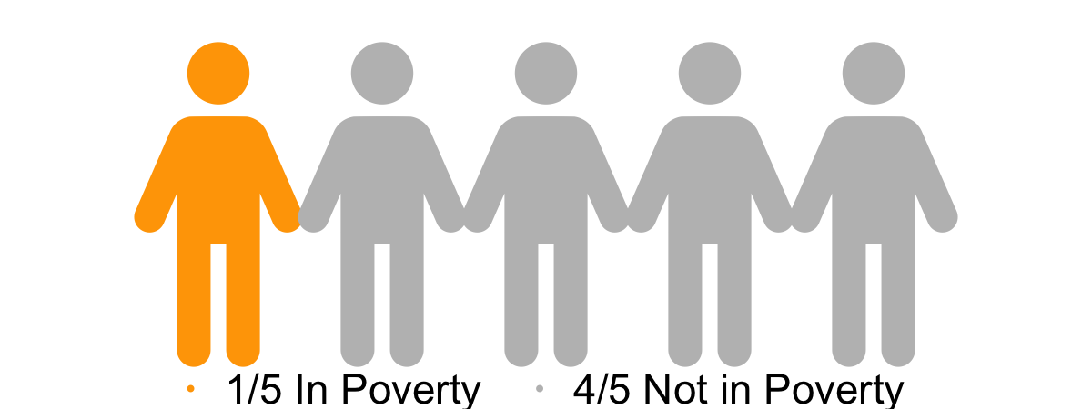
Profile of Monterey County Children & Youth
Notes:
Deneen Talking points:
There are approximately 114,000 children under 18 living in Monterey County which is 26.4% of the population. Of them, 21.6% live in poverty. For 18 to 24 year old, 17% live in poverty. For children under six, 96.8% have health insurance. For six to 18 year olds, 983% have health insurance and for 19 to 25 year olds 86.2% have insurance.

Slide 6
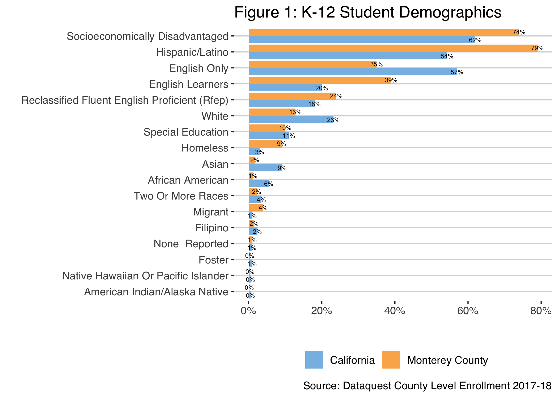
Notes:
Monterey County enrolled K-12 students represent a diversity of backgrounds. Socioeconomically Disadvantaged students (74%) and Latinx students (79%) make up the largest proportion of our students. Of children under 5, 76% are Latinx, and of youth 18 to 24, 66% are Latinx. Socioeconomically Disadvantaged students are defined by the 2018 California School Dashboard Technical Guide FINAL VERSION: 2018–19 School Year as: students that are migrant, foster, homeless at any time during the academic year, eligible for Free or Reduced-Priced Meal (FRPM) Program (also known as the National School Lunch Program), or had direct certification for FRPM at any time during the academic year at the testing school, or the students’ parents’ education level is marked as “both parents did not received a high school diploma” at the time of testing.

Slide 7
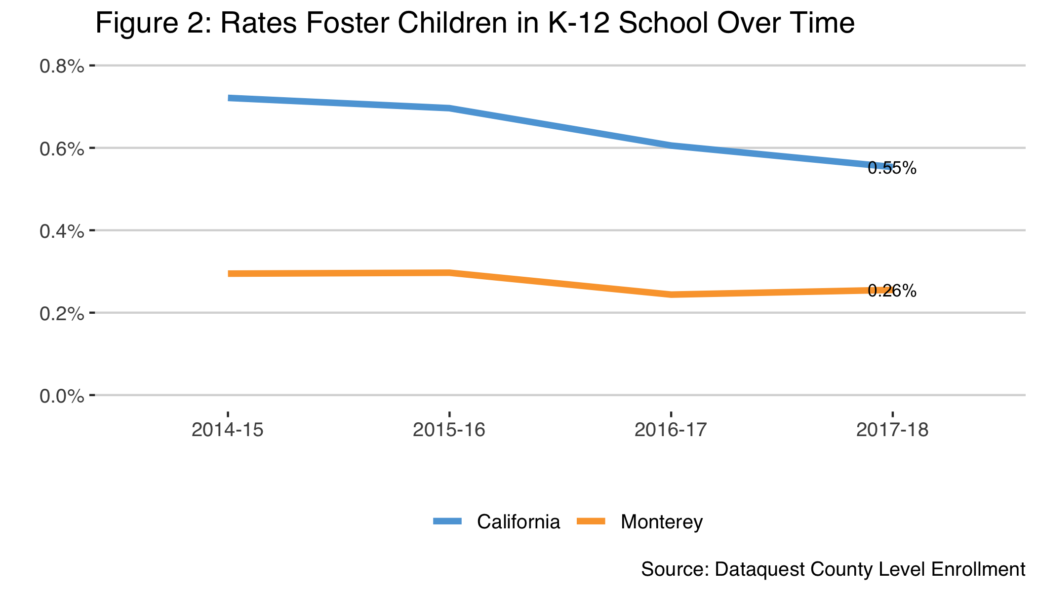
Notes:
While the rate for California has gone down over the past four years it is still more than double the rate in Monterey County. The
rate for Monterey County has remained relatively flat. There were 199 identified foster youth enrolled in 2017-18.

Slide 8
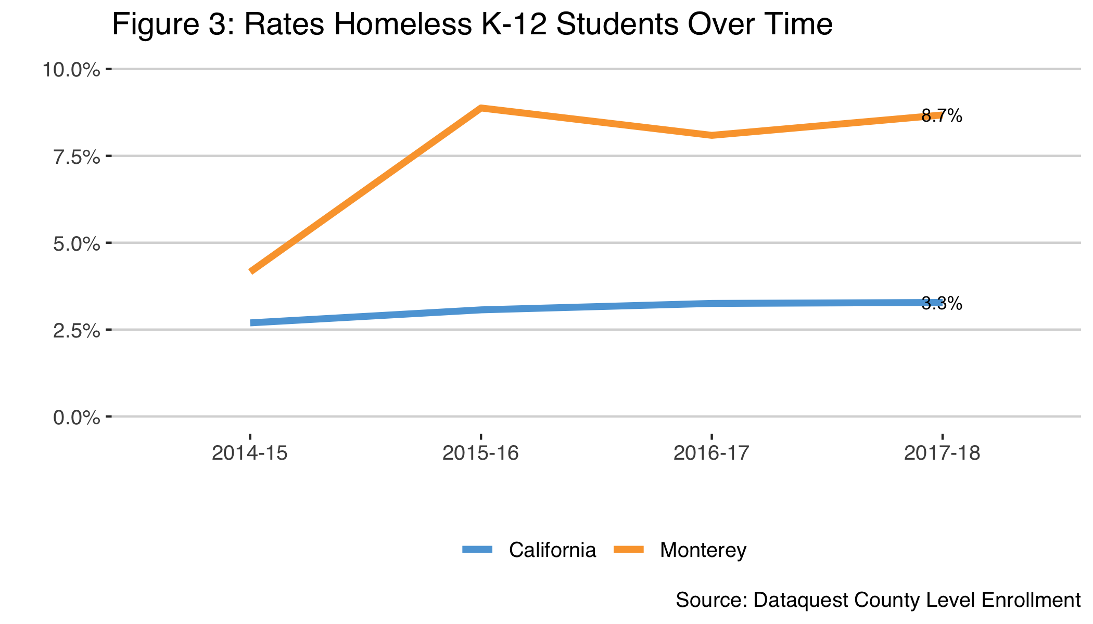
Notes:
Monterey County has more than twice the rate of homeless students than California. Homeless students are one of the subgroups that have the lowest graduation rates in Monterey County and in California.

Slide 9
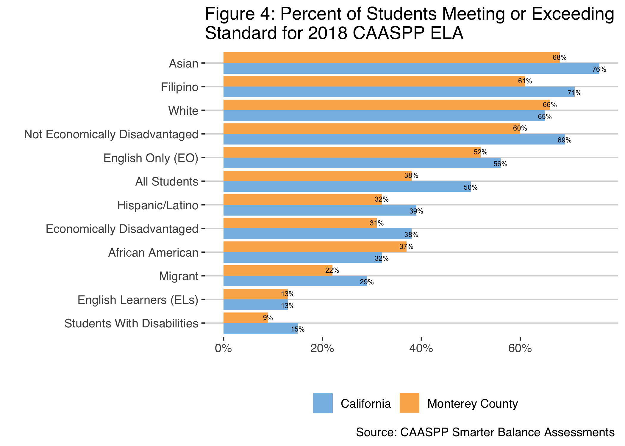
Notes:
Not depicted on this charge but on Page 11 of the Annual Report it shows the “All Students” group improving in EL Arts annually. 2014-15 was first year of new test and improvements have been made each year with 2018-19 at 38%. We are showing continued progress with incremental growth, but are still lower than the state.
More African Americans and White Students in Monterey County are achieving standards on CAASPP ELA tests than these groups throughout California. For the past four years. ELA scores have increased annually for most grade levels and most subgroups.

Slide 10
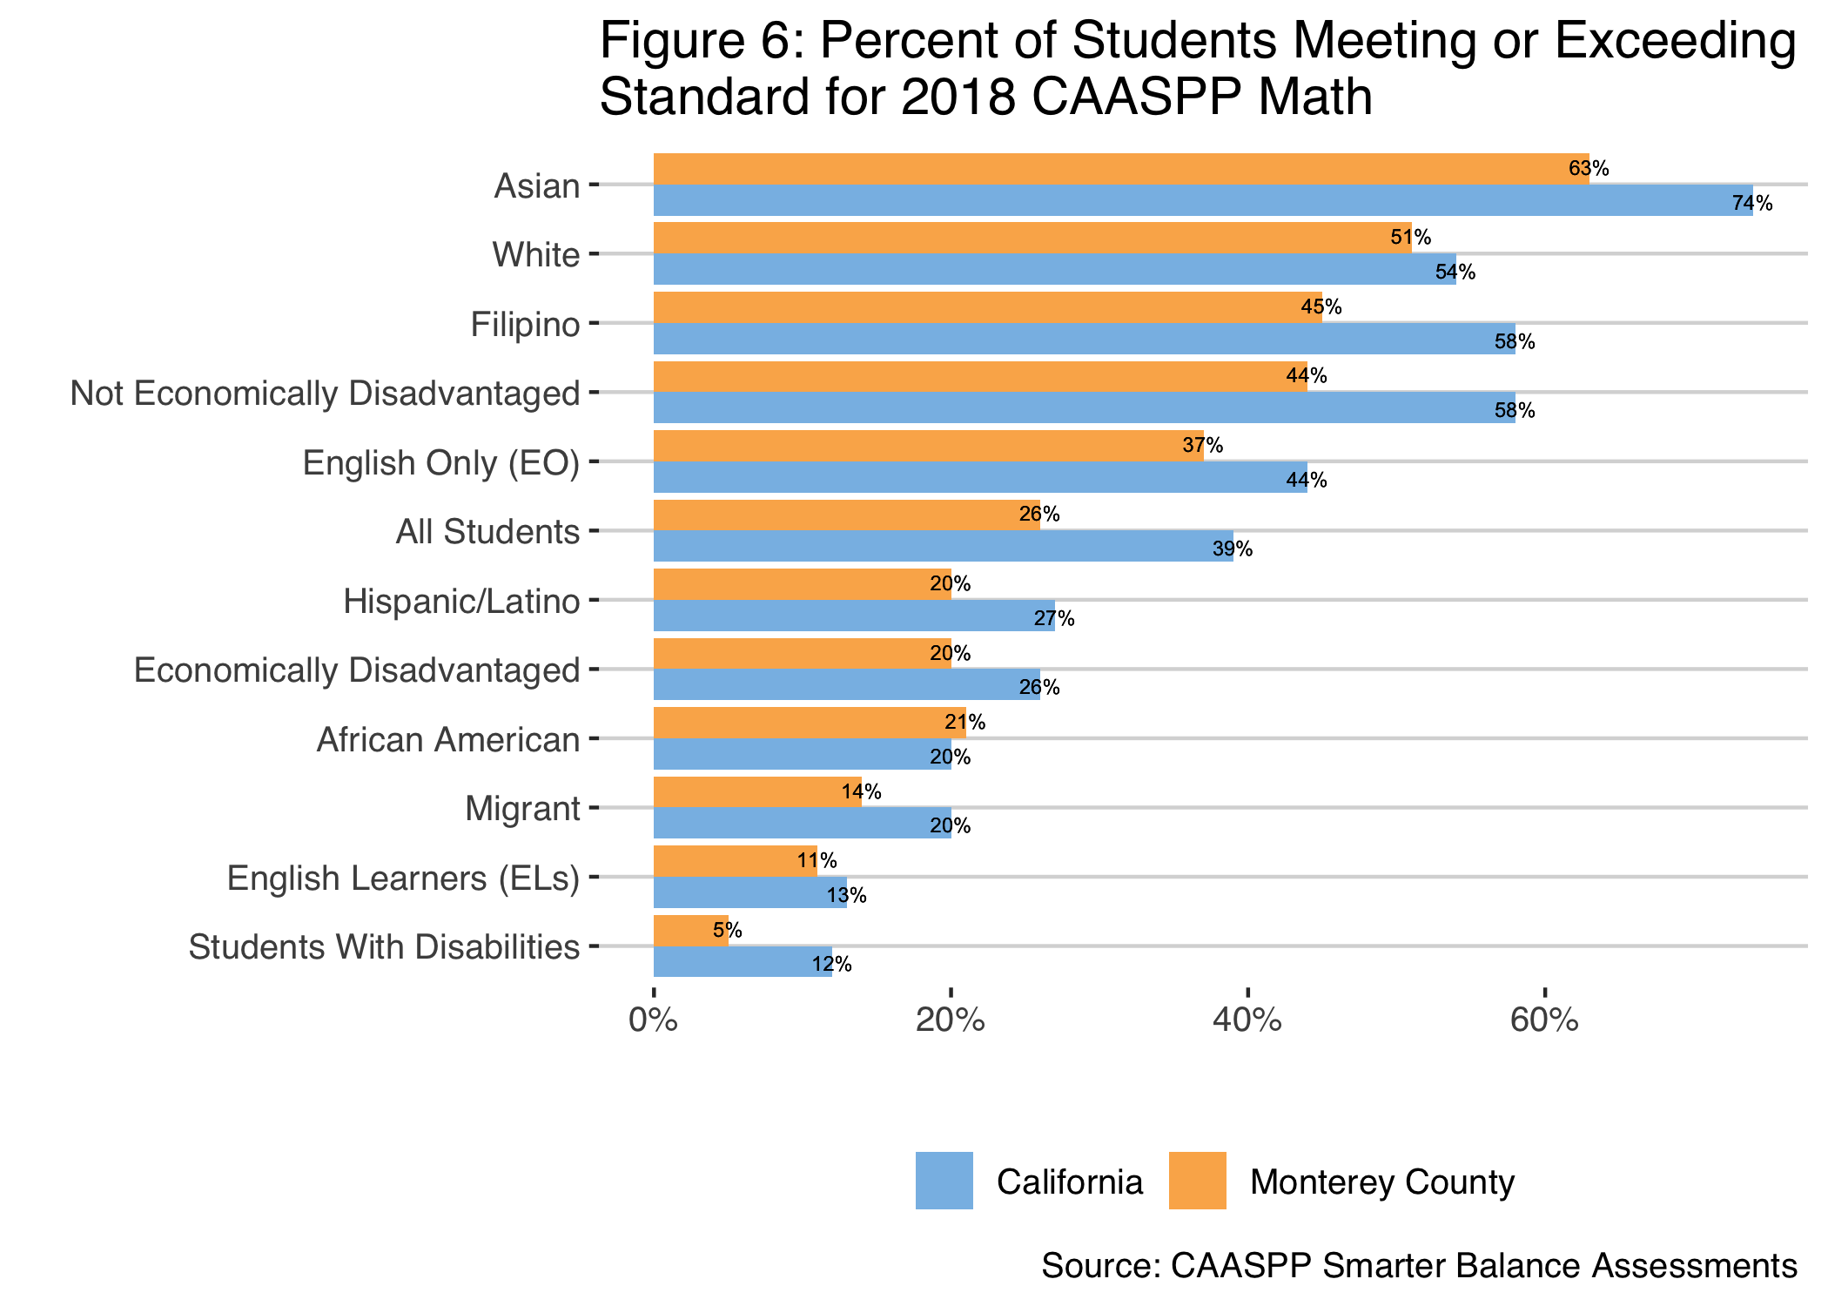
Notes:
Again, more African American in Monterey County are achieving standards on Math tests than California. Math scores have increased annually for most grade levels and most subgroups.

Slide 11
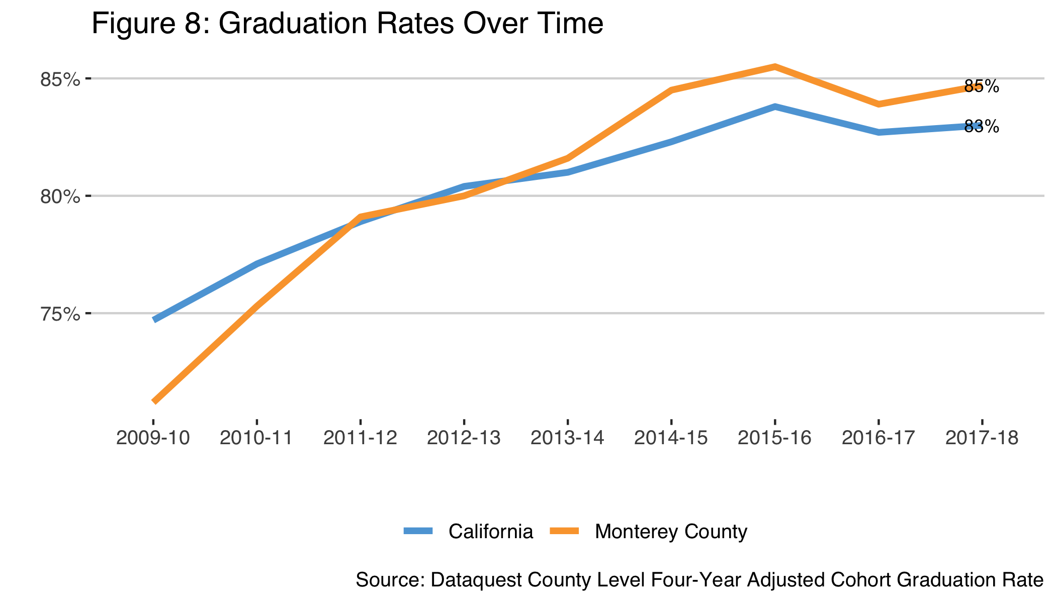
Notes:
Graduation rates have steadily grown over the past decade and are now higher than California. Our patterns parallel California. Filipino and Asian students show the highest graduation rates on average.

Slide 12
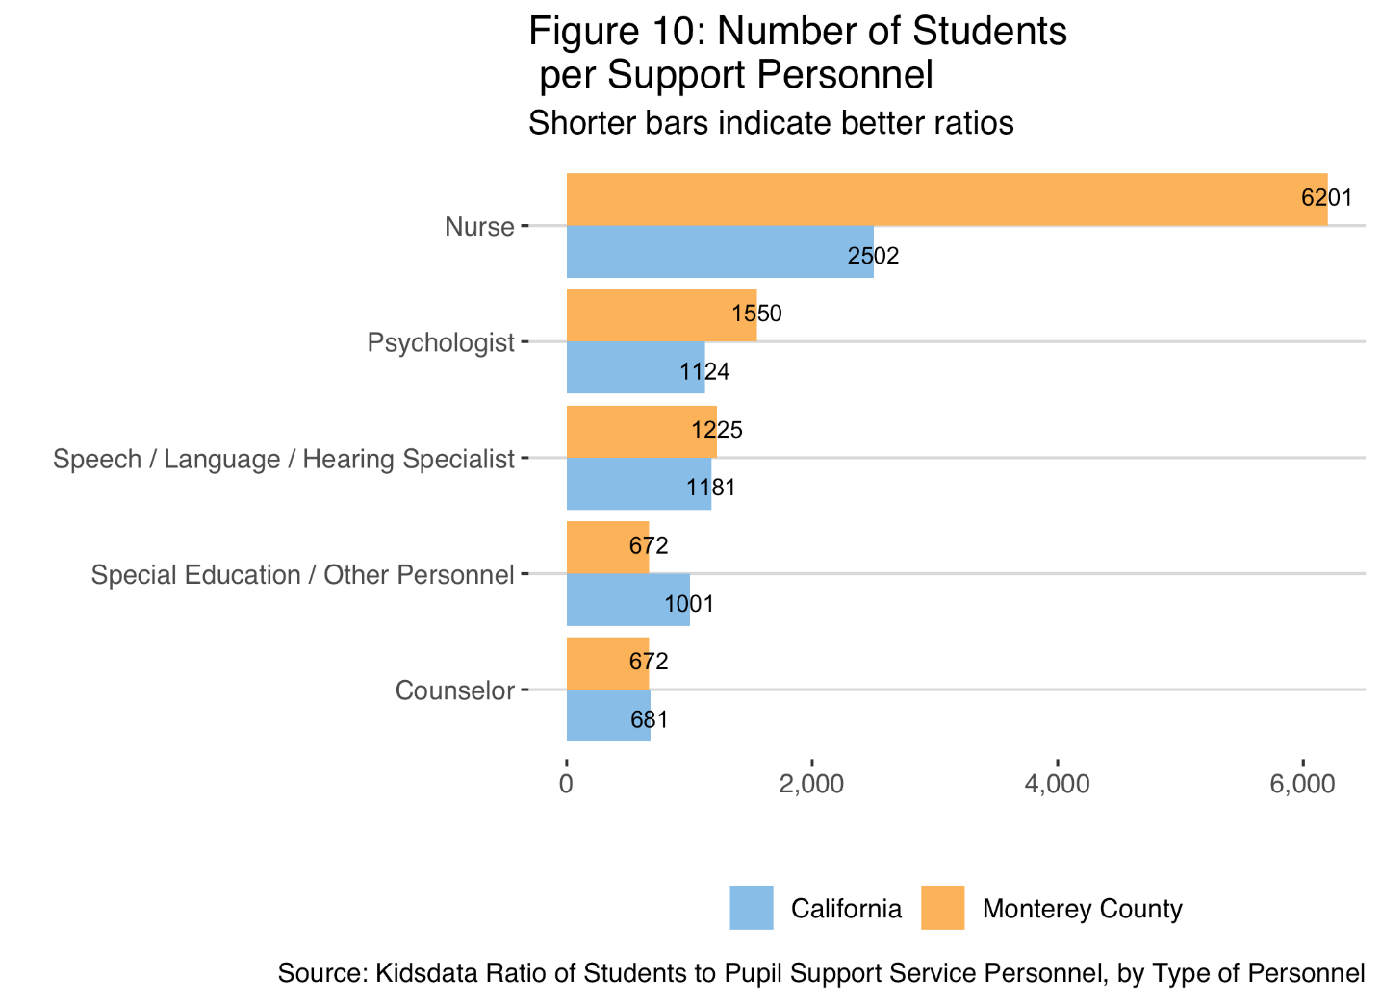
Notes:
Monterey County students have fewer nurses and psychologists per students than California as a whole

Slide 13
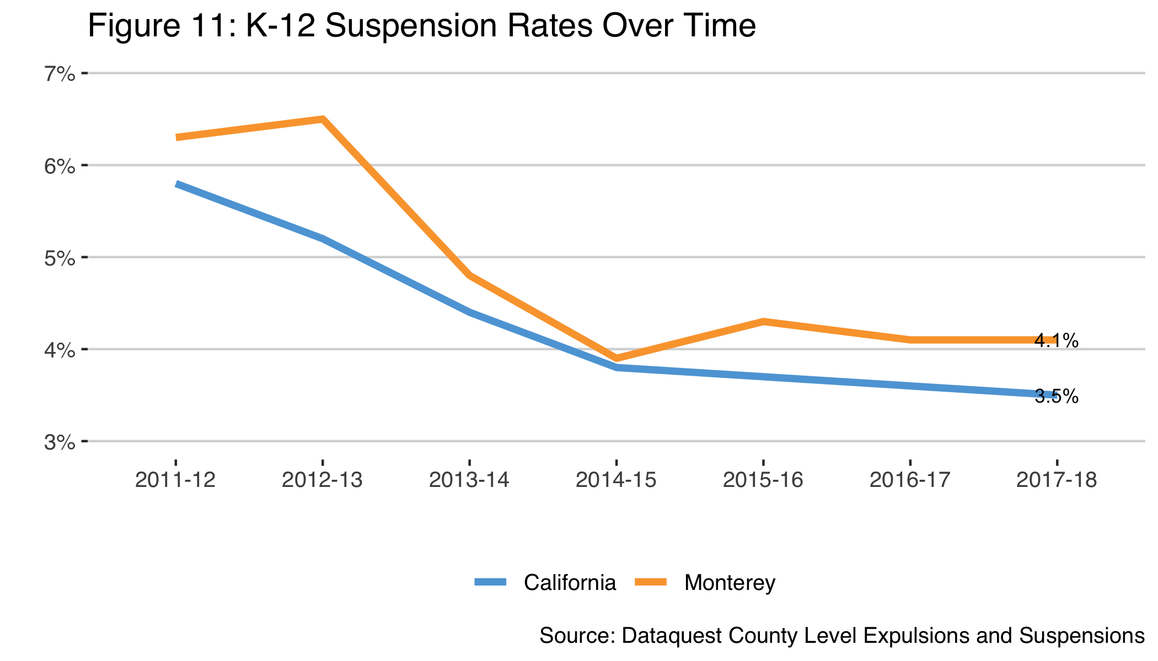
Notes:
Suspension dropped largely between 2011-12 and 2014-15. The rates have remained steady since 2014-15.

Slide 14
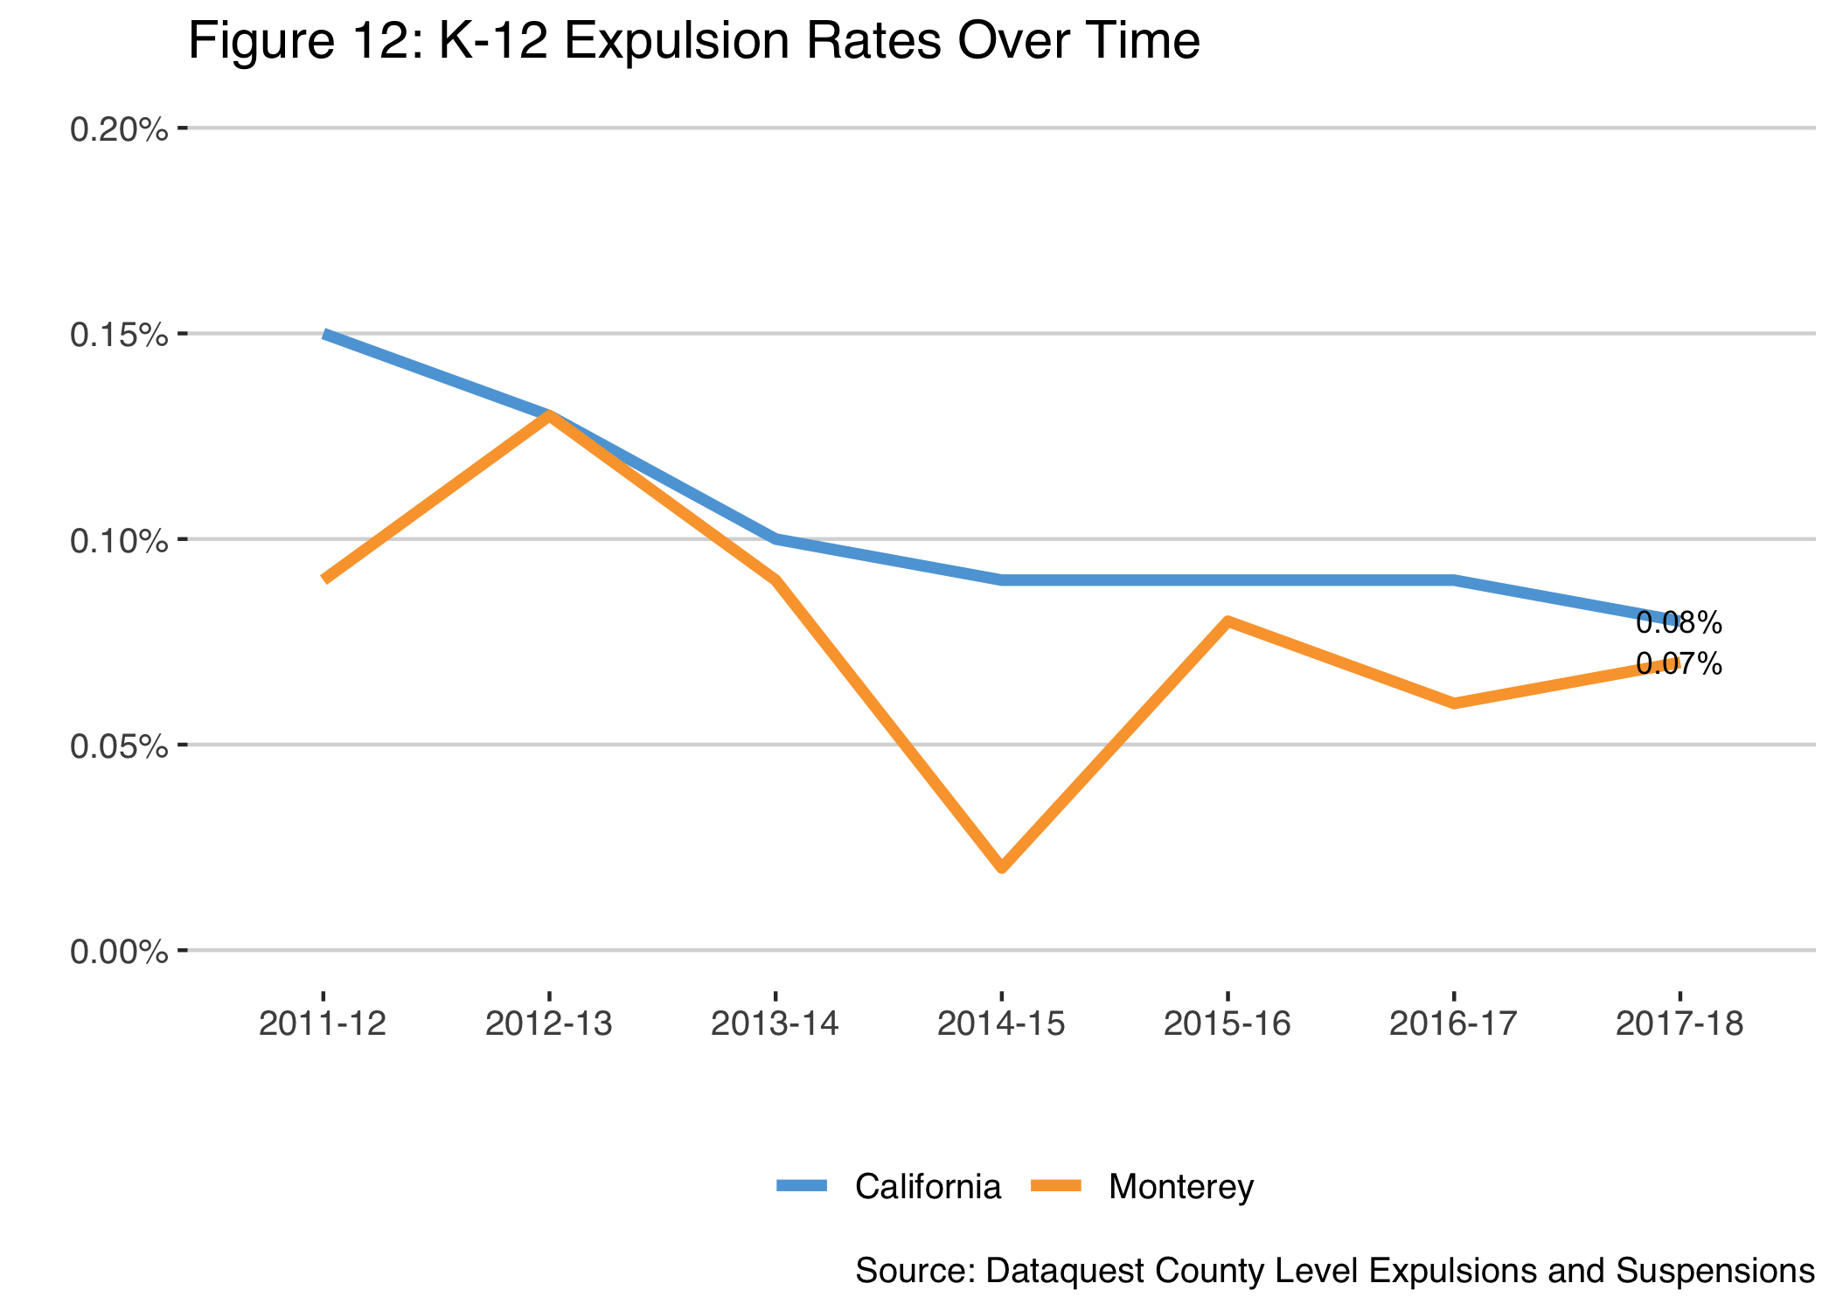
Notes:
Expulsions, while varying more because of low numbers, remain marginally lower than California as a whole.

Slide 15
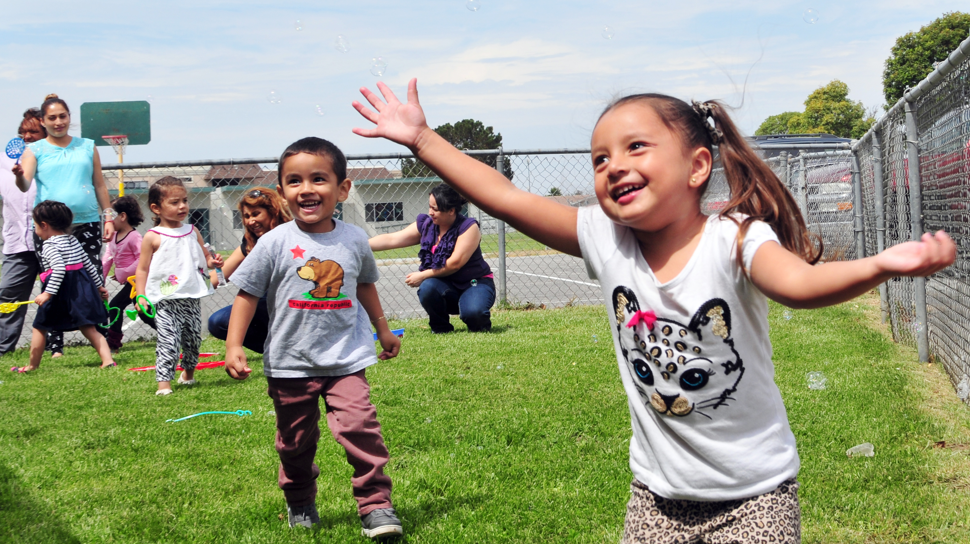

Early Childhood Development Initiative Presented by Francine Rodd, Co-Chair

Slide 16
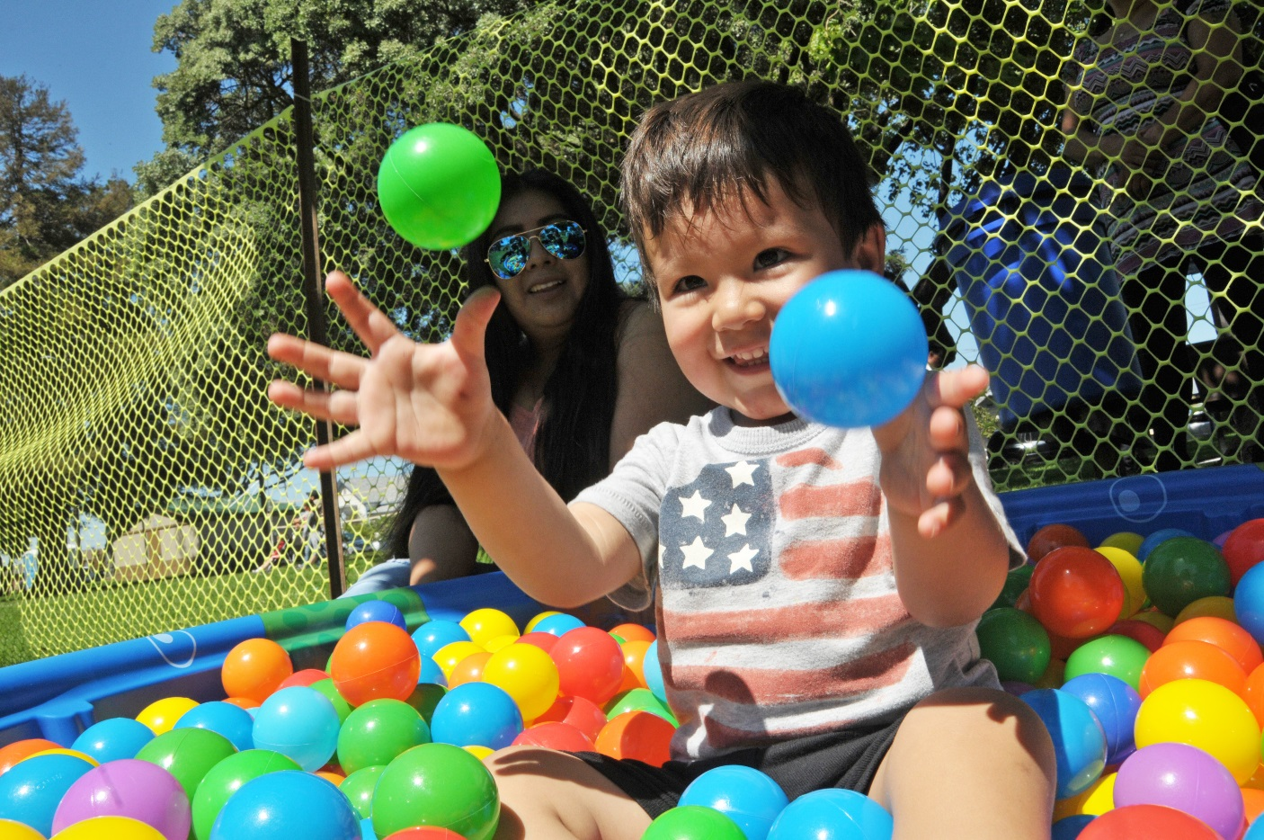
Bright Beginnings Vision
All children in Monterey County
live in safe, nurturing homes and communities; they are healthy, valued, succeed in school and realize their full potential.

Slide 17
Background
Launched in 2012 by the Children’s Council as a collective impact initiative for holistic early childhood development
First 5 Monterey County serves as fiscal sponsor and hosts staff
Responsible for Goals 1 & 2 Bright Futures cradle to career initiative:
Access to quality early care & education
Kindergarten readiness
In 2014 catalyzed six community-based collective action teams

Slide 18
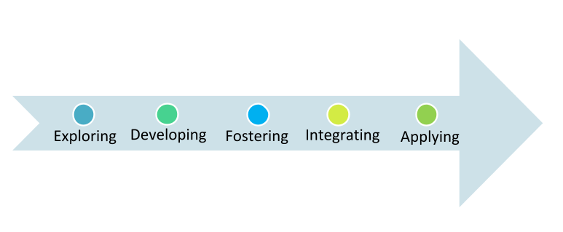
Building Capacity around Collective Impact
Shared Measurement:
Defined community-level goals, articulated results chain connecting aligned actions to factors influencing child development, developing TOC and MEAL for projects.
Learning Culture: Sharing of lessons with other collective impact efforts, at ECD Advisory Groups, and with project teams.
Common Vision:
Articulated in the ECD countywide strategic plan: “Together, preparing every child for school and life.”
Mutually Reinforcing Action: Implementing projects and policy advocacy strategies (see Big Win Two); early wins in several communities through CATS; leveraging existing networks and catalyzing new teams.
Continuous Communication: Established public media presence on TV and radio. Both external and internal communication are regular (e.g., monthly eNewsletter), and support learning culture and common vision.
Notes:
NEEDS TRIMMING on slide, add to notes

Slide 19
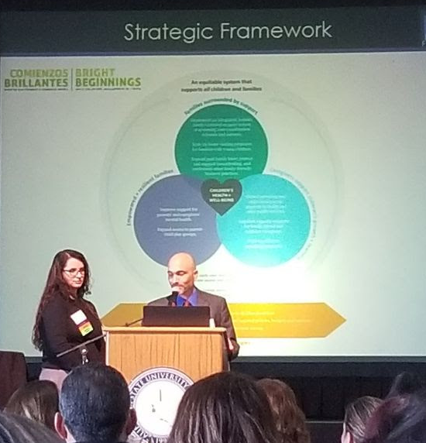
Launch ECD Strategic Plan
“Together, preparing every child for life and school”
Notes:
Cross-sector, multi-disciplinary strategic planning process included 25+ agencies over 6+ months, co-facilitated by Bright Beginnings and United Way. Planning group continues to meet quarterly as the ECD Advisory Group, providing technical expertise to moving the countywide strategy forward.
This strategic plan aims to change the way we as a community think about young children and their families, and the ways we all work together to support them. The plan uses a systems approach, takes an equity lens, and identifies a shared commitment to the following core values for aligned action:
Holistic view of children and families.
Power of interconnected community systems.
RIght of all children to access equitable opportunities.
Culturally responsive and trauma-informed practices.
Co-creating solutions.
Tenacious focus on results.
Informed by research.

Slide 20
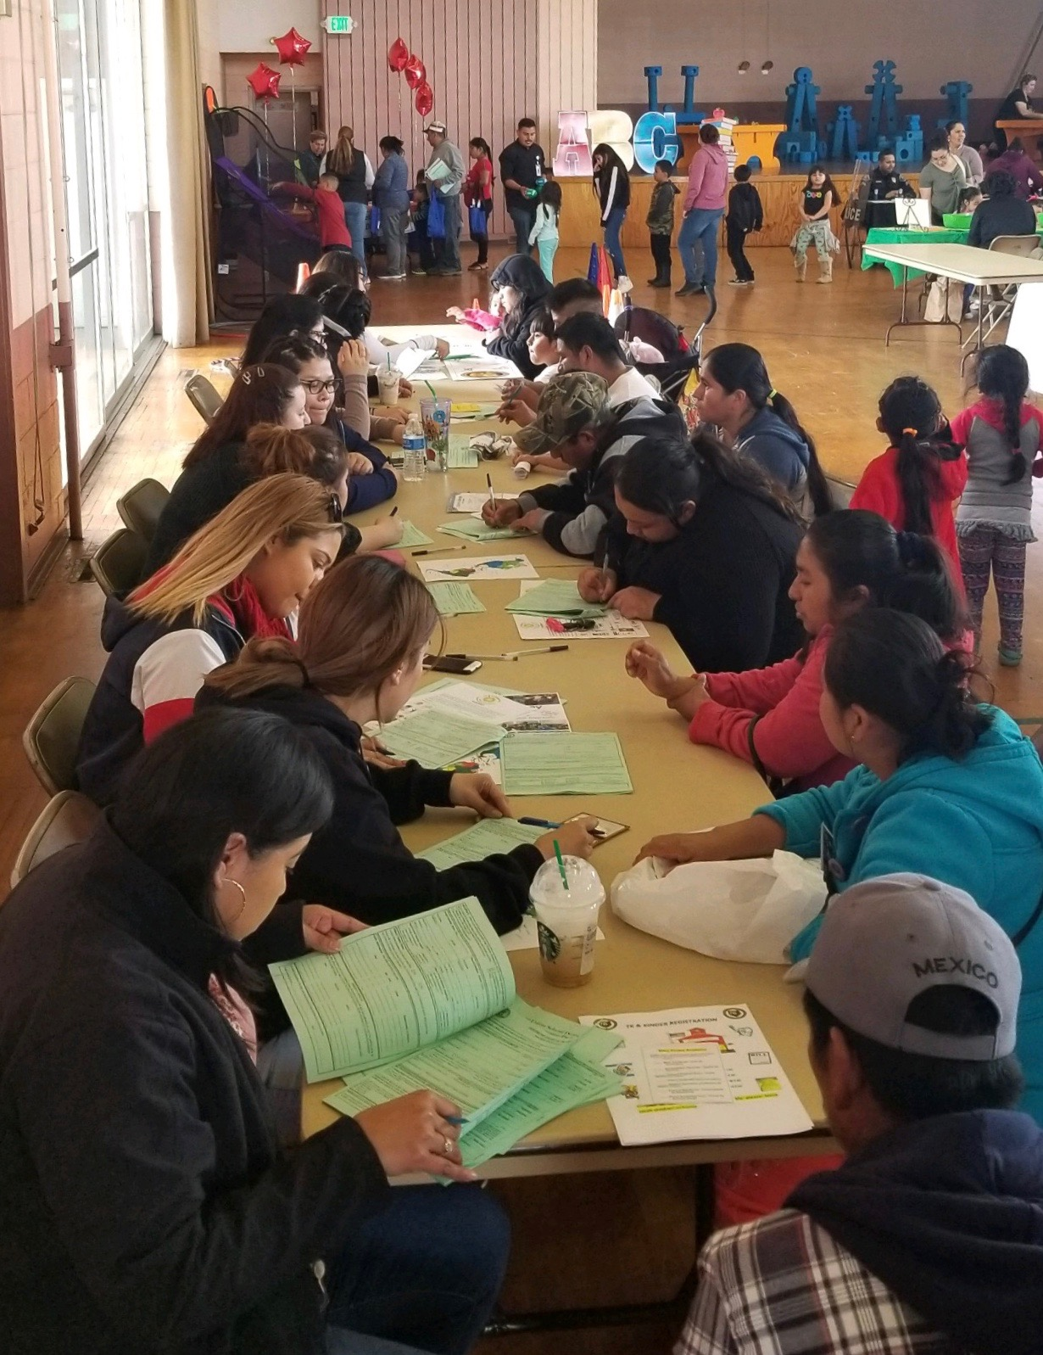
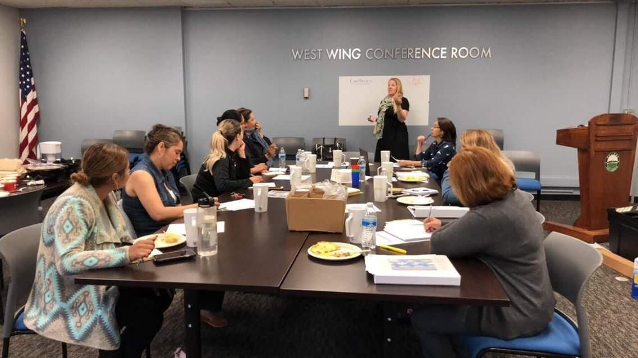
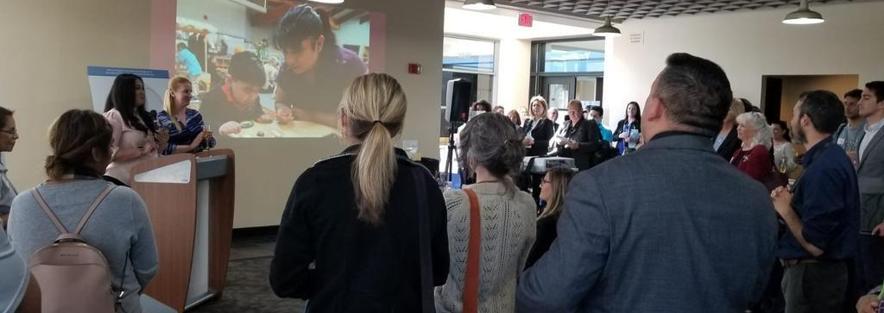
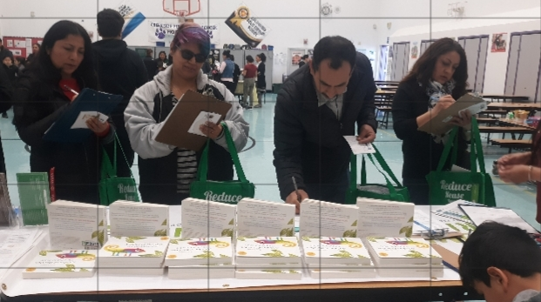
Galvanized Strategy Aligned Action
Pajaro Promotoras
Maternal Mental Health
FFN Caregiver Capacity Building
Impact of Immigration
Salinas Preschool for All
Greenfield TK/Kinder Resource Fair
Gonzales FFN Caregiver Playgroups
Family Friendly Business Certification
City of Gonzales Children in All Policies
Child Care Resource & Referral Website
Workforce Development Website
Grant Writing for State Contracts
School Readiness Assessment Pilot
Community Solutions: Resourcing Slots
Home Visiting Hub
TK+ Network
Notes:
After launched, super-resourced existing projects and catalyzed new ones for FY 2018-19 (incoming)
NOTE add something like: “presentations to Council on immigration, and regular updates on policy and current issues that young children and families face , like homelessness.”

Slide 21
Galvanized Strategy Aligned Action
Pajaro Promotoras
Maternal Mental Health
FFN Caregiver Capacity Building
Impact of Immigration
Salinas Preschool for All
Greenfield TK/Kinder Resource Fair
Gonzales FFN Caregiver Playgroups
Family Friendly Business Certification
City of Gonzales Children in All Policies
Child Care Resource & Referral Website
Workforce Development Website
Grant Writing for State Contracts
School Readiness Assessment Pilot
Community Solutions: Resourcing Slots
Home Visiting Hub
TK+ Network
Notes:
After launched, super-resourced existing projects and catalyzed new ones for FY 2018-19 (incoming)
NOTE: animations fixed
NOTE add something like: “presentations to Council on immigration, and regular updates on policy and current issues that young children and families face , like homelessness.”

Slide 22
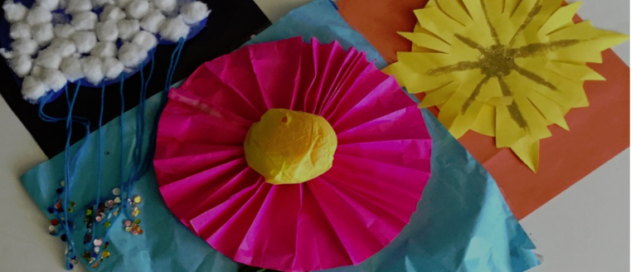
2019 Sneak Preview
Grow support from County
Deepen Current Strategic Activities
Increase Policy & Advocacy Involvement
Hone Key Performance Indicators
Upgrade Organizational Development
Broaden Communications
Notes:
Grow support from County:
Reinstate general funds for Backbone
Homevisiting Coordination Hub
Maternal Mental Health Awareness
ECE Systems Transformation
Deepen Current Strategic Activities
Hone Key Performance Indicators: Better align with TOCs & MEALs of strategic activities
Upgrade Organizational Development: governance (decision making processes & resource allocation)

Slide 23
Our Community Charter:
To ensure that every child
is prepared for school,
succeeds in and out
of school,
completes a post-high school credential,
and
enters a
promising career.
Notes:
We formed the Partnership around this basic charter
To ensure that every child:
is prepared for school
achieves in and out of school
completes a post-high school credential
enters a promising career
This is simple, and clear. But it has required and will continue to require hard work to close the gaps from where we are today.
In 2015, our community set a 10 year goal – and that is to triple the number of kids who achieve a post-high school credential, raising the bar from 20% to 60% by 2026.
To date, we have improved about 5%. We are moving in the right direction. We also have a long ways to go.

Slide 24




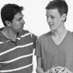


7 Goals for Improvement
Who are their early teachers?
Are they ready for school?
Can they read and write?
Can they solve the problems?
Who matters to them?
Are they ready?
Can they find a promising career?
1
2
3
4
5
6
7
Early Care
Kinder- Ready
Language & Literacy
Critical Thinking
Youth Development and Engagement
College Ready
Career Prepared
Notes:
We analyzed over 100 data points that told us where kids fall behind and fall out of the education pathway. After prioritizing these “pain points”, we identified 7 top priority goals. When we improve in these 7 priority goal areas, we will see many more children and youth succeed.
During 2018, The Monterey Children’s Council engaged with Bright Futures around Goal 5: Youth Development and Engagement

Slide 25
Youth Development and Engagement
Measuring Youth Development
Importance of Prevention
Inventory of Youth-Serving Organizations
Potential Vision for the Future

Slide 26
Measuring Youth Development
Discussed current measurement of youth development and engagement in schools
California Health Kids Survey (CHKS)
Positive Behavioral Intervention and Supports (PBIS)
CORE Data Collaborative
LCAP School Climate
Aligning in-school and out-of-school measures to support youth development and engagement
Out-of-school measurement of similar outcomes would lead to better understanding of program impact on youth

Slide 27
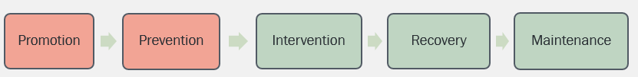
Importance of Prevention
Discussed continuum of care
Although differed by agency, general consensus that more efforts are needed in promotion and prevention
Potential to reach youth early to influence positive choices

Slide 28
Inventory of Youth Serving Programs
Collectively agreed on importance of understanding youth-serving programs throughout the County
Bright Futures, United Way, Community Alliance for Safety and Peace
Feedback from Children’s Council regarding key information to collect
Identified over 130 organizations to contact
Survey is currently being conducted
Plan to geo-map to reveal overlap and underserved communities

Slide 29
Potential Vision for the Future
Discussed ways to support “promotion” and “prevention” through existing youth programs
Suggestions to address funding and talent needs
Professional association
Shared services
Support departments shared by multiple youth serving programs (e.g. recruiting, hiring, evaluation, staff training, etc.)
Outside Support
Support learning from in school programs (e.g. tiered intervention for trauma, PBIS, etc.)
“Warm referral” system
Possibly United Way’s 2-1-1

Slide 30
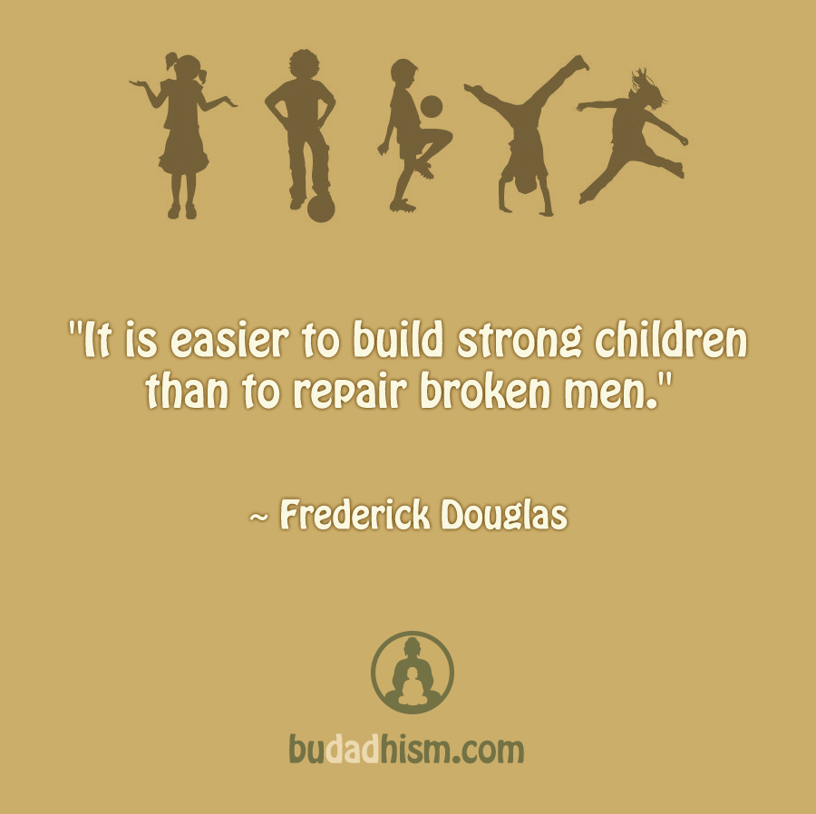
Thank you!
Notes:
Photo

